Slide 1
Web Automation
CS 383

Slide 2
What is Web Automation?
Web automation is the concept of letting software robots perform pre-defined actions, tasks, and processes on a web browser or web application.

Slide 3
Web Automation
Think of all the clicking and typing you do at your desk every day involving websites and web-based applications. All these actions can be automated with web automation.
Actions that can be automated include:
Filling out forms and fields
Scraping content from a web page
Extracting and transferring data between applications
Clicking buttons and elements

Slide 4
Web Automation
very day, in businesses of all sizes, there are scenarios where automating tasks like these would come in handy. For example:
Importing contacts into a CRM system from a third-party service
Testing the user experience and order handling of an online shop
Integrating a web-based ERP-system with a document management platform in the cloud

Slide 5
Selenium browser automation
The world’s most popular open-source framework for automating browsers.
The Selenium tool suite consists of:
Selenium WebDriver, an automation tool built for automating in the browser
Selenium IDE, a record and playback tool
Selenium Grid, a parallel testing tool
All components of the Selenium suite are open-source tools for automation of websites and web applications, and not other types of applications, such as desktop.

Slide 6
Selenium browser automation
WebDriver is an API that can automate any action that takes place in a web browser. It drives browser actions natively, meaning that it interacts with browser elements, such as clicking on buttons and typing text in fields, like a real user would.
Selenium WebDriver is operated by writing code in a programming language, such as C#, JavaScript, PHP or Python.

Slide 7
Selenium browser automation
Download and install Python:
Download Python | Python.org
Install PiP for Python
pip · PyPI
Install selenium using pip: CMD>> pip install selenium
Install Chrome Webdriver (Each browser have different webdriver)
For more details about the setup:
Python Selenium Tutorial #1 - Web Scraping, Bots & Testing - YouTube

Slide 8
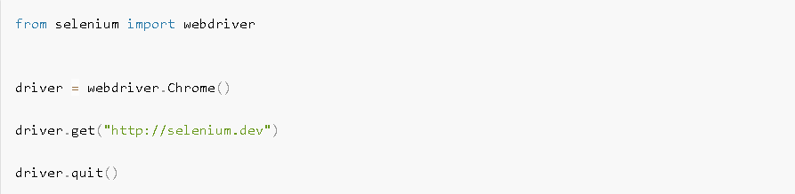
Selenium browser automation
Example of using Selenium.
Example 1:
Use Chrome web browser
Write the automation code using Python:
Open the web browser
Navigate to the website
Close the web browser

Slide 9
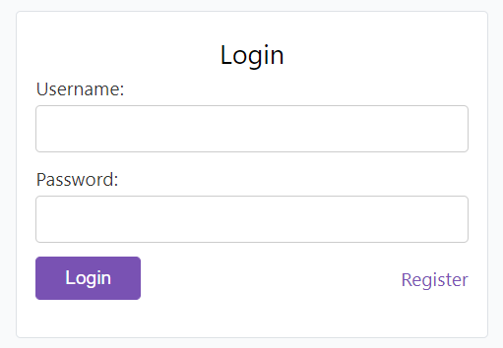
Selenium browser automation
Example of using Selenium.
Example 2:
Use Chrome web browser
Write the automation code using Python:
Open the web browser
Navigate to the web application
Select the username, password Html elements
Enter the values of the username and password
Select and Click the login Button

Slide 10
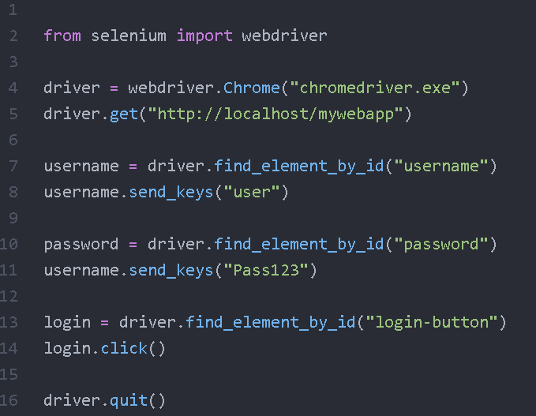
Selenium browser automation

